Slide 1



Noida Institute of Engineering and Technology, Greater Noida
Full-Stack Web Development using Laravel with
Vue.JS
Unit: III
Laravel Authentication&Laravel Faker
Rupendra Kaushik
(Asst. Professor)
CSE Department
Course Details (B. Tech. 6th Sem)
Rupendra Kaushik laravel Authentication Unit III

Slide 2

Brief Introduction of Faculty
COURSE | BOARD/UNIVERSITY | YEAR OF PASSING
M.Tech | ITM, AKTU, Lucknow | 2022
B.Tech | PKITM, AKTU, Lucknow | 2014
Automatic Image Captioning Using
Ensemble of Deep Learning Techniques ” has been published in the AIR 2022
Organizing in Motilal Nehru National Institute of Technology Prayagraj.
A Comprehensive Review on Image Captioning Using Deep learning ” has been published in the AIR 2022 Organizing in Motilal Nehru National Institute of Technology Prayagraj.
AREA OF INTEREST
Deep Learning, Web Development and Nural Network
Rupendra Kaushik laravel Authentication Unit III

Slide 3
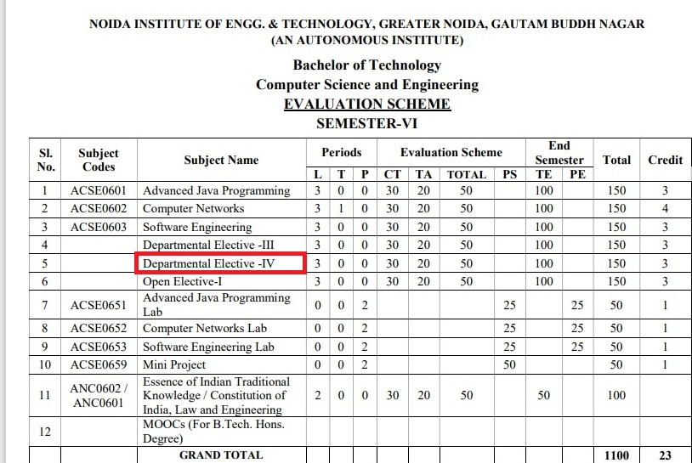
Evaluation Scheme
Rupendra Kaushik laravel Authentication Unit III

Slide 4
Syllabus
UNIT-I: Introduction to Laravel
Introduction to Laravel, Laravel Features, Laravel installation, Application Structure of Laravel, Root Directory, App Directory, Basic Configuration, Environmental Configuration, Routing, Routing Parameters, Middleware, Terminable Middleware, Middleware Parameter, Controllers, Restful Resource Controllers, Implicit Controllers, Constructor Injection, Method Injection, Laravel Sail, Laravel Jetstream.
Rupendra Kaushik laravel Authentication Unit III

Slide 5
Syllabus
UNIT-II: Vue.js Framework&Inertia.js
Vue.js Template Syntax And Expressions, Vue directives, loops and conditional rendering, VueDevtools, Handling user Inputs, Handling Events, Vuejs Methods and Computed Properties, Attribute Bindings and dynamic classes, Concepts of Inertia.js, How it works, Inertia protocol, Routing, Responses and Pages, Creating links, GET, POST,PUT, PATCH, and DELETE method in Inertia.js
Rupendra Kaushik laravel Authentication Unit III

Slide 6
Syllabus
UNIT-III: Laravel Authentication&Laravel Faker
Laravel design pattern, Laravel blade template engine, Artisan command, Login with username or email, Register with username or email, Logout, Validate request data (required, unique, etc..), Protecting Router, Password Confirmation, Social & Other Authentication method, Show success / Failure message, Faker PHP library, Create data seeder, Seed data, Localisation, Model Factories
Rupendra Kaushik laravel Authentication Unit III

Slide 7
Syllabus
UNIT-IV: Connecting Laravel with databases
Database Configuration File, Read/Write connections, Running A Select Query, Running an Insert, Update, Delete Statement, Listening For Query Events, Database Transaction, rollback and commit method, Accessing connections, Query Logging, Laravel Query Builder & ORM, Laravel Migration& Eloquent.
Rupendra Kaushik laravel Authentication Unit III

Slide 8
Syllabus
UNIT-V: Deployment Laravel application to production
PHPExtension:BCMath,Ctype,cURL,JSON,Mbstring,OpenSSL,PCRE,PDOServer Configuration, Nginx, Laravel server management service LaravelForge, Autoloader optimization, Optimizing Configuration Loading, Optimizing Route Loading, Optimizing View Loading, Debug Mode, Deploying With Vapor.
Rupendra Kaushik laravel Authentication Unit III

Slide 9
Branch Wise Application
Adaptability: It gives bother free migration, basic, and efficient structure.
Components: They help in creating custom elements that can be reused in HTML.
Transition: Various methodologies are given in Vue.js to apply a transition to HTML components when they are included or expelled from the DOM.
Detailed Documentation: It gives a simple learning curve through point-by-point documentation
Rupendra Kaushik laravel Authentication Unit III

Slide 10
Course Objective
1.Laravel Development Means Faster Time-To-Market. ...
2.Better Authentication and Authorization Option. ...
3.Stay Away from Technical Vulnerabilities with Laravel Framework. ...
4.MVC Architecture of Laravel Framework. ...
5.Automated and Unit Testing Feature. ...
6.Automated Task Execution and Scheduling
Rupendra Kaushik laravel Authentication Unit III

Slide 11
Course Outcomes (COs)
CO : 01. | Apply the knowledge of PHP that are vital in understanding Laravel application and analyze the concepts, principles and methods in current Server-side technology to implement Laravel application over the web.
CO : 02. | Explain, analyze and apply the role of Client-side scripting language like Vuejs in the workings of the web and web applications.
CO : 03. | Implementing and analyzing the concept of Larvel Faker and Authentication on Laravel.
CO : 04. | Understand the impact of web designing by database connectivity with different databases in the current market place where everyone use to prefer electronic medium for shoping, commerce, and even social life also.
CO : 05. | Analyzing and Creating a functional website using Laravel and Vuejs and Deploying and Optimizing Web Application using Forge / Vapor.
Rupendra Kaushik laravel Authentication Unit III

Slide 12
Program Outcomes (POs)
PO : 01. | Engineering Knowledge
PO : 02. | Problem Analysis
PO : 03. | Design/Development of solutions
PO : 04. | Conduct Investigations of complex problems
PO : 05. | Modern tool usage
PO : 06. | The engineer and society
PO : 07. | Environment and sustainability
PO : 08. | Ethics
PO : 09. | Individual and teamwork
PO : 10. | Communication
PO : 11. | Project management and finance
PO : 12. | Life-long learning
Rupendra Kaushik laravel Authentication Unit III

Slide 13
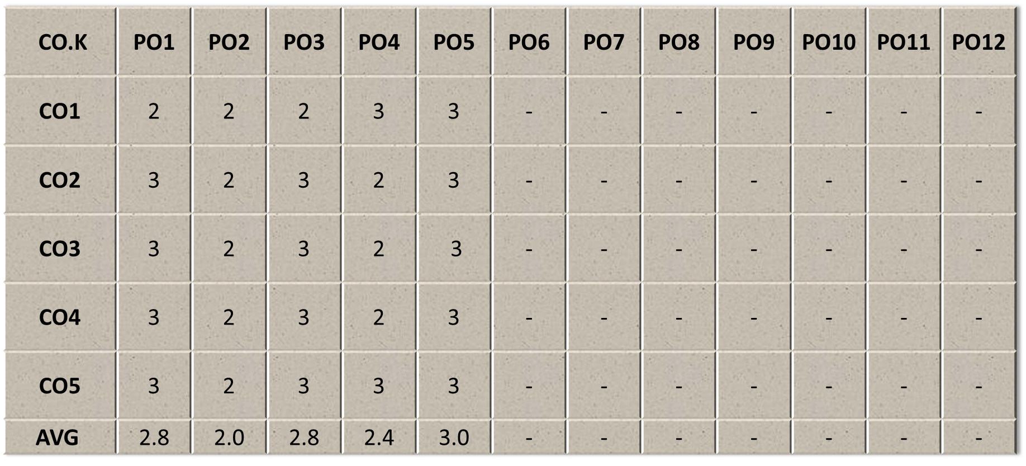
COs - POs Mapping
Rupendra Kaushik laravel Authentication Unit III

Slide 14
Program Specific Outcomes(PSOs)
Sr. No. | PSO Description
PSO1 | The ability to identify, analyze real world problems and design their ethical solutions using artificial intelligence, robotics, virtual/augmented reality, data analytics, block chain technology, and cloud computing.
PSO2 | The ability to design and develop the hardware sensor devices and related interfacing software systems for solving complex engineering problems.
PSO3 | The ability to understand inter-disciplinary computing techniques and to apply them in the design of advanced computing.
PSO4 | The ability to conduct investigation of complex problems with the help of technical, managerial, leadership qualities, and modern engineering tools provided by industry-sponsored laboratories.
Rupendra Kaushik laravel Authentication Unit III

Slide 15
COs - PSOs Mapping
CO.K | PSO1 | PSO2 | PSO3 | PSO4
CO1 | 3 | - | - | -
CO2 | 3 | 3 | - | -
CO3 | 3 | 3 | - | -
CO4 | 3 | 3 | - | -
CO5 | 3 | 3 | - | -
Rupendra Kaushik laravel Authentication Unit III

Slide 16
Program Educational Objectives (PEOs)
Sr. No. | PEOs Description
PEO 1 | To have an excellent scientific and engineering breadth so as to comprehend, analyze, design and provide sustainable solutions for real-life problems using state-of-the-art technologies.
PEO 2 | To have a successful career in industries, to pursue higher studies or to support entrepreneurial endeavors and to face the global challenges.
PEO3 | To have an effective communication skills, professional attitude, ethical values and a desire to learn specific knowledge in emerging trends, technologies for research, innovation and product development and contribution to society.
PEO4 | To have life-long learning for up-skilling and re-skilling for successful professional career as engineer, scientist, entrepreneur and bureaucrat for betterment of society.
Rupendra Kaushik laravel Authentication Unit III

Slide 17
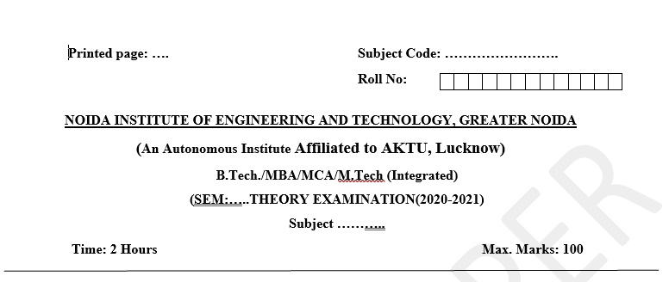
Pattern of Online External Exam Question Paper (100 marks)
Rupendra Kaushik laravel Authentication Unit III

Slide 18
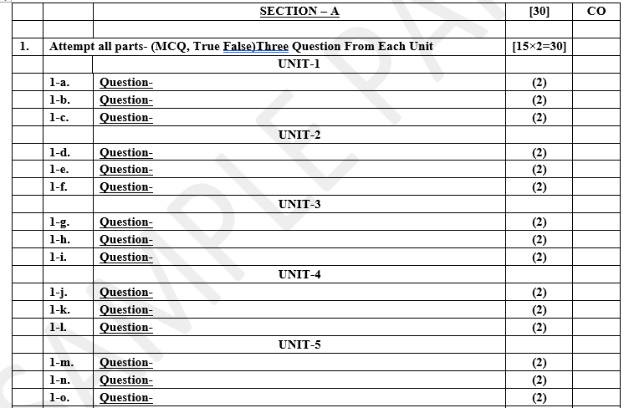
Pattern of Online External Exam Question Paper (100 marks)
Rupendra Kaushik laravel Authentication Unit III

Slide 19
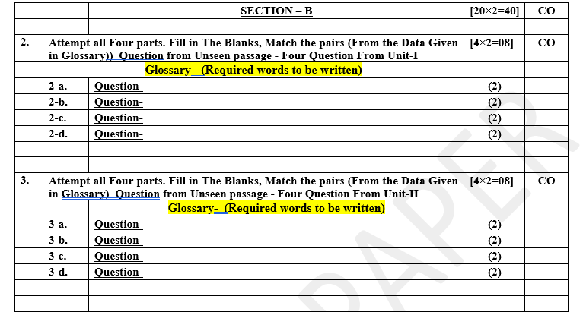
Pattern of Online External Exam Question Paper (100 marks)
Rupendra Kaushik laravel Authentication Unit III

Slide 20
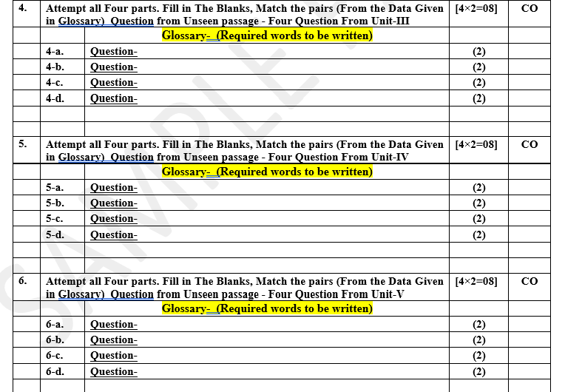
Pattern of Online External Exam Question Paper (100 marks)
Rupendra Kaushik laravel Authentication Unit III

Slide 21
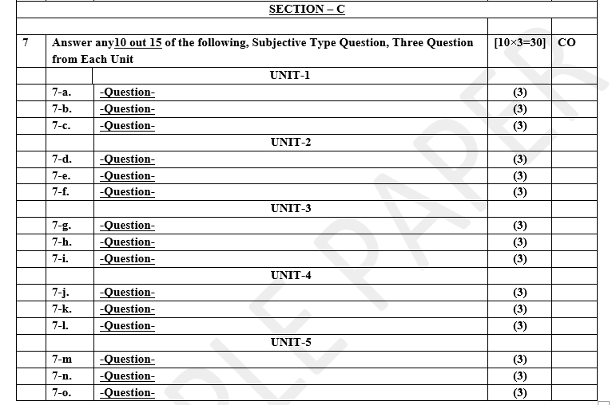
Pattern of Online External Exam Question Paper (100 marks)
Rupendra Kaushik laravel Authentication Unit III

Slide 22
Result Analysis
Branch | Result
CSE | 100%
IT | 98%

Slide 23
Prerequisite and Recap
Before begin progressing with this tutorial, we assume that we are familiar with website development using PHP and MySQL also we should be familiar with HTML, Core PHP, and Advance PHP. We have applied Laravel version 5.1 in all the examples.
Rupendra Kaushik laravel Authentication Unit III

Slide 24
Brief Introduction about the Subject with videos
YouTube /other Video Links:
https://www.youtube.com/watch?v=1onmPIe07yo&ab_channel=Bitfumes
https://www.youtube.com/watch?v=AhM4nAxaTLo&ab_channel=StellaLi
https://www.youtube.com/watch?v=AEVhRhD2Wk&ab_channel=MattSocha
https://www.youtube.com/watch?v=DfslJ-kaZXA&ab_channel=GeekyShows
Rupendra Kaushik laravel Authentication Unit III

Slide 25
Unit Content
Laravel design patter, Laravel blade template engine, Artisan command, Login with username or email, Register with username or email, Logout, Validate request data (required, unique, etc..), Protecting Router, Password Confirmation, Social & Other Authentication method, Show success / Failure message, Faker PHP library, Create data seeder, Seed data, Localisation, Model Factories.
Rupendra Kaushik laravel Authentication Unit III

Slide 26
Unit Objective
In this unit Student will learn Laravel Authentication.
Laravel attempts to take the pain out of development by easing common tasks used in the majority of web projects, such as authentication, routing, sessions, and caching.
Laravel aims to make the development process a pleasing one for the developer without sacrificing application functionality.
Rupendra Kaushik laravel Authentication Unit III

Slide 27
Topic Objective
Topic :Laravel design patter
Laravel design pattern aims to separate each algorithm into separate components so that they can be reused or combined in other parts of the application easily. This approach also brings flexibility and makes it easy to change an algorithm system wide.
Rupendra Kaushik laravel Authentication Unit III

Slide 28
Laravel design pattern
Every programming language has a specific design pattern. This is design pattern categories into 6 parts.
Builder pattern
Factory pattern
Strategy pattern
Provider pattern
Repository pattern
Facade pattern
1.Builder pattern:
The Builder pattern is one of the main design patterns of Laravel. It separates the construction of a complex object from its representation so that the same construction process can create different representations. A builder is good for creating complex products.
Rupendra Kaushik laravel Authentication Unit III

Slide 29
Laravel design pattern
A real-life example of the Builder pattern is the construction of a car. Let’s think we have a builder class called CarBuilder.
class CarBuilder
{
public function make(CarBuilderInterface $car):Car {
$car->start();
$car->break();
return $car; }
}
It returns an object which implements the Car interface. Those start() and break() methods are defined into CarBuilderInterface initially.
interface CarBuilderInterface
{
public function start();
public function break();
}
Rupendra Kaushik laravel Authentication Unit III

Slide 30
Laravel design patter
Now, if we want to make a new car, at first we have to create an object of the CarBuilder class and then create a new car using builder which returns the Car instance. The code of creating an object of the CarBuilder is given below-
class CarBuilder{
public function make(CarBuilderInterface $car):Car
{
$car->start();
$car->break();
return $car;
}
}
//Create a object of CarBuilder class
$carBuilder= new CarBuilder();
//Create car using builder which returns Car instance
$car= $carBuilder->make(new CaroneBuilder());
Rupendra Kaushik laravel Authentication Unit III

Slide 31
Laravel design patter
Now we can add much functionality to CaroneBuilder as our needs.
class CaroneBuilder implements CarBuilderInterface
{
protected $car;
public function start():Car
{
$this->car = new Car();
return $this->car;
}
public function break():Car
{
$this->car = new Car();
return $this->car;
}
}
Rupendra Kaushik laravel Authentication Unit III

Slide 32
Laravel design patter
Factory pattern:
The Factory pattern is a creational pattern that uses factory methods to deal with the problem of creating objects by specifying their concrete classes. The factory is responsible for creating objects, not the clients. Multiple clients can call the same factory.
Let’s go with the example of a car. If we want to make a car, we need a lot of parts like battery, radiator, brake, fuel tank, etc. To create those car parts, we need a factory.
Now, we can create those parts of our own. But it’s time-consuming and let’s think we don’t want to wait that long instead of we want a quick process like we just want to assemble a car.
We can contact different companies who sell those parts and buy from them. So, in this case, those companies are the creator or factories.
Rupendra Kaushik laravel Authentication Unit III

Slide 33
Laravel design patter
We don’t care how they make them as long as we get those parts. With this factory pattern, it’s easy to test, mock and isolate.
interface CarFactoryContract
{
public function make(array $carbattery = []): Car;
}
class CarFactory implements CarFactoryContract
{
public function make(array $carbattery = [])
{
return new Car($carbattery);
}
}
$car= (new CarFactory)->make('lithium', 'nickel', 'cobalt');
Rupendra Kaushik laravel Authentication Unit III

Slide 34
Laravel design patter
So, if we look at this simple car factory example, we have CarFactory which is responsible to make a car, and in the end, we get an instance of a car.
Laravel uses this same pattern for the views. Let’s see an example:
class PostsController
{
public function index()
{
$posts= Post::all();
return view('posts.index', ['posts' => $posts]);
}
}
In this case, we’re using the view helper and calling the view method. Here, the view method is the helper method, which is calling the factory in the end. We give the view some data which the view needs to build.
Rupendra Kaushik laravel Authentication Unit III

Slide 35
Laravel design patter
/**
* @return \Illuminate\View\View\Illuminate\Contracts\View\Factory
* /
function view($view = null, $data = [], $mergeData = [])
{
$factory = app(ViewFactory::class);
if(func_num_args() === 0){
return $factory;
}
return $factory->make($view, $data, $mergeData);
}
When we look at the helper method, we see a factory is created which is the view factory. This factory calls the make() method and this method is a factory method that always creates and returns the view object for us. This factory is responsible for creating the views we use in our controller.
Rupendra Kaushik laravel Authentication Unit III

Slide 36
Laravel design patter
Strategy pattern:
The strategy pattern is a behavioral pattern. Defines a family of interchangeable algorithms. It always uses an interface. This means the implementation details remain in separate classes. Its programs are to an interface, not an implementation.
Let’s go with the example of the car. Suppose, we have a new car ready and we’re going to deliver it. To deliver the car, we need a strategy. There are many ways to deliver a car. At first, we need to define the interface.
interface DeliveryStrategy
{
public function deliver(Address $address):DeliveryTime;
}
Rupendra Kaushik laravel Authentication Unit III

Slide 37
Laravel design patter
Here, our interface name is DeliveryStrategy. In this interface, we have a method called deliver. We’re going to provide an address and it’ll return something for us. So, each strategy needs a deliver method and an address object.
class ShipDelivery implements DeliveryStrategy
{
public function deliver(Address $addrress):
{
$route= new ShipRoute($address);
echo $route->calculateCosts();
echo $route->calculateDeliveryTime();
}
}
Rupendra Kaushik laravel Authentication Unit III

Slide 38
Laravel design patter
For example, we’re going to deliver the car by ship. The shipping delivery uses the shipping route. It calculates the delivery costs and time for us. We can now create a CarDelivery class that expects one of the delivery strategies and deliver the car to us.
class CarDelivery
{
public function deliverCar(DeliveryStrategy $strategy, Address $address)
{
return $strategy->deliver($address);
}
}
$address= new Address('example address 12345');
$delivery= new CarDelivery();
$delivery=>deliver(new ShipDelivery(), $address);
Rupendra Kaushik laravel Authentication Unit III

Slide 39
Laravel design patter
Provider pattern:
The provider pattern is the core of the Laravel framework and the packages we use. It’s a set of patterns for some essential services. It’s like a plug-in or packages into our service.
It provides classes that we can use in our namespace. Suppose, we’re going to sell Toyota’s car and want to create our franchise. Toyota will give us the way to build cars. How we set up our warehouse, it’s totally up to us.
But, the ways of making all the cars, necessary car parts and all the paperwork they’ll provide to us. So, in that case, they are the provider. In this case, our CarBuilder or CarManager is provided by Toyota.
class ToyotaServiceProvider extends ServiceProvider
{
public function register(){
//Register your services here
}
}
Rupendra Kaushik laravel Authentication Unit III

Slide 40
Laravel design patter
So, when we look at the provider pattern, we have a register method here like a normal service provider. So, basically, we need to tell Laravel that we have an implementation available for us in the code.
use App\Toyotas\CarManager;
class CarServiceProvider extends ServiceProvider
{
public function register()
{
$this->app->bind('car-manager', function($app) {
return new CarManager();
});
}
}
When want to access that manager class for our application, we have to bind it to our ServiceProvider and it becomes available in our code. Basically, we ask laravel to create the class for us, when we ask for that string.
Rupendra Kaushik laravel Authentication Unit III

Slide 41
Laravel design patter
Repository pattern:
In simple words, the Repository pattern in a laravel application is a bond between models and controllers. In this process, the model should not be responsible for connecting with or retrieving data from the database. Therefore, to keep our code clean and safe, it is necessary to use the repository. It reduces the duplication and errors of our code.
Let’s think of an example, we have a customer table in our database, where we can add, store, edit and delete customer data. We also have a Customer model. The idea is, we’re going to create an interface and define some methods. Like this-
Rupendra Kaushik laravel Authentication Unit III

Slide 42
Laravel design patter
TestInterface.php:
<?php
//(Here the App\Repositories is the folder name)
namespace App\Repositories;
interface TestInterface
{
public function all();
public function get($id);
public function store(array $data);
public function update($id, array $data);
public function delete($id);
}
?>
Rupendra Kaushik laravel Authentication Unit III

Slide 43
Laravel design patter
For this tutorial, our interface name is TestInterface and we have five methods called all(), get(), store(), update() and delete(). Now our interface is created, we need to create a repository. In the repository, we’re going to call these methods from the interface and implement them. Let’s create a repository-
<?php
//(Here the App\Repositories is the folder name)
namespace App\Repositories;
use App\Models\Customer;
class TestRepositoryOne implemets TestInterface
{
//To view all the data
public function all()
{
return Customer::get();
}
Rupendra Kaushik laravel Authentication Unit III

Slide 44
Laravel design patter
//Get an individual record
public function get($id)
{
return Customer::find($id);
}
//Store the data
public function store(array $data)
{
return Customer::create($data);
}
//Update the data
public function update($id, array $data)
{
return Customer::find($id)->update($data);
}
//Delete the data
public function delete($id)
{
return Customer::destroy($id);
}
}
?>
Rupendra Kaushik laravel Authentication Unit III

Slide 45
Laravel design patter
Facade pattern:
The facade pattern provides a combined interface to a set of interfaces in a subsystem. A facade defines a higher-level interface that makes the subsystem easier to use.
The facade pattern isn’t all about covering up bad code, though. It can be used to create a simple public interface that bonds multiple classes working together in some way. Suppose you’re dealing with a large subsystem with hundreds of public methods but you only need a few of them.
You want the facade to correctly construct the various classes in the subsystem and provide those interfaces to you such that you can use them with ease. All of Laravel’s facades are defined in the Illuminate\Support\Facades namespace. Let’s see an example-
Rupendra Kaushik laravel Authentication Unit III

Slide 46
Laravel design patter
In this App\Repositories folder, let’s create a PHP file called Addition.php.
Addition.php:
<?php
namespace App\Repositories;
class calculation
{
public function sum() {
$a = 10;
$b = 20;
$result = $a + $b; }
}
?>
We have a class called calculation and it has a function called sum. It’s a simple function that returns the sum of two numbers. Now, we can access this function in our application from anywhere. For that, at first, we have to bind it to our service provider.
Rupendra Kaushik laravel Authentication Unit III

Slide 47
Topic Objective
Topic :Laravel blade template engine
Laravel Blade template engine enables the developer to produce HTML based sleek designs and themes. All views in Laravel are usually built in the blade template. Blade engine is fast in rendering views because it caches the view until they are modified.
Rupendra Kaushik laravel Authentication Unit III

Slide 48
Laravel blade template engine
Blade Template
The Blade is a powerful templating engine in a Laravel framework. The blade allows to use the templating engine easily, and it makes the syntax writing very simple. The blade templating engine provides its own structure such as conditional statements and loops. To create a blade template, you just need to create a view file and save it with a .blade.php extension instead of .php extension. The blade templates are stored in the /resources/view directory. The main advantage of using the blade template is that we can create the master template, which can be extended by other files.
Why Blade template?
Blade template is used because of the following reasons:
Displaying data If you want to print the value of a variable, then you can do so by simply enclosing the variable within the curly brackets.
Syntax
{{$variable}};
Rupendra Kaushik laravel Authentication Unit III

Slide 49
Laravel blade template engine
In blade template, we do not need to write the code between
<?php echo $variable; ?>.
The above syntax is equivalent to <?= $variable ?>.
Ternary operator In blade template, the syntax of ternary operator can be written as:
{{ $variable or 'default value'}}
The above syntax is equivalent to
<?= isset($variable) ? $variable : ?default value? ?>
Rupendra Kaushik laravel Authentication Unit III

Slide 50
Laravel blade template engine
Blade Template Control Statements
Blade templating engine also provides the control statements in laravel as well as shortcuts for the control statements.
<html>
<body>
<font size='5' face='Arial'>
@if(($id)==1)
student id is equal to 1.
@else
student id is not equal to 1
@endif
</font>
</body>
</html>
Rupendra Kaushik laravel Authentication Unit III

Slide 51
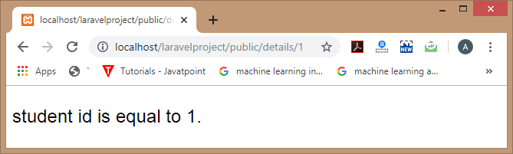
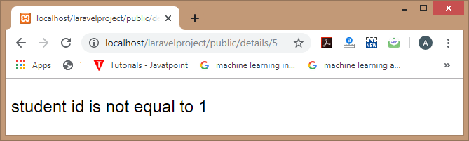
Laravel blade template engine
Output :
Rupendra Kaushik laravel Authentication Unit III

Slide 52

Laravel blade template engine
Blade template provides @unless directive as a conditional statement. The above code is equivalent to the following code:
<html>
<body>
<font size='5' face='Arial'>
@unless($id==1)
student id is not equal to 1.
@endunless
</font>
</body>
</html>
Rupendra Kaushik laravel Authentication Unit III

Slide 53
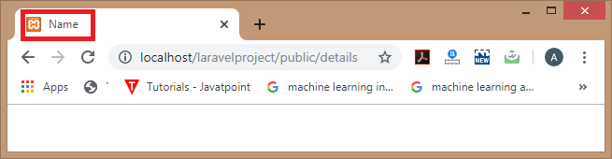
Laravel blade template engine
@hasSection directive
The blade templating engine also provides the @hasSection directive that determines whether the specified section has any content or not.
Let's understand through an example.
<html>
<body>
<title>
@hasSection('title')
@yield('title') - App Name
@else
Name
@endif
</title>
</font>
</body>
</html>
Rupendra Kaushik laravel Authentication Unit III

Slide 54
Laravel blade template engine
Blade Loops
The blade templating engine provides loops such as @for, @endfor, @foreach, @endforeach, @while, and @endwhile directives. These directives are used to create the php loop equivalent statements.
@for loop
First, we create the student.blade.php file in resources/views directory.
Student.blade.php
value of i :
@for($i=1;$i<11;$i++)
{{$i}}
@endfor
Now, add the following code in PostController.php file.
public function display()
{
return view('student');
}
Rupendra Kaushik laravel Authentication Unit III

Slide 55
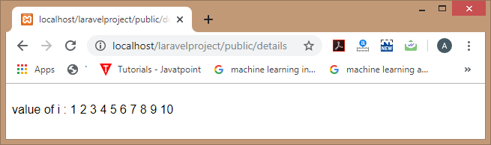
Laravel blade template engine
Add the route in the web.php file.
Route::get('/details', 'PostController@display’);
@foreach loop
First, we create the student.blade.php file in resources/views directory.
@foreach($students as $students)
{{$students}}<br>
@endforeach
Rupendra Kaushik laravel Authentication Unit III

Slide 56
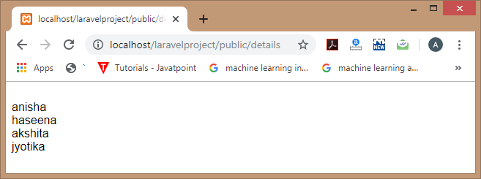
Laravel blade template engine
Now, add the following code in the PostController.php file.
public function display()
{
return view('student', ['students'=>['anisha','haseena','akshita','jyotika']]);
}
In the above code, we are passing the students array to the student.blade.php file.
Add the route in the web.php file.
Route::get('/details', 'PostController@display');
Rupendra Kaushik laravel Authentication Unit III

Slide 57
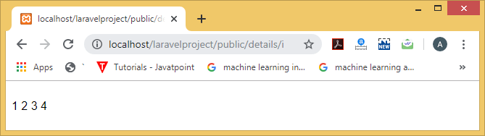
Laravel blade template engine
@while loop
First, we create the student.blade.php file in resources/views directory.
@while(($i)<5)
javatpoint
{{$i++}}
@endwhile
Now, add the following code in PostController.php file.
public function display($i)
{
return view('student');
}
Add the route in web.php file.
Route::get('/details/{i}', 'PostController@display');
Rupendra Kaushik laravel Authentication Unit III

Slide 58
Topic Objective
Topic :Artisan command
Artisan is a command-line interface that Laravel provides which helps in making the production process fast and easy. Laravel has its own Command Line interface called Artisan.
Rupendra Kaushik laravel Authentication Unit III

Slide 59
Artisan command
Artisan is the name of the command-line interface included with Laravel. It provides a number of helpful commands for your use while developing your application. It is driven by the powerful Symfony Console component.
Usage
Listing All Available Commands
To view a list of all available Artisan commands, you may use the list command:
php artisan list
Viewing The Help Screen For A Command
Every command also includes a "help" screen which displays and describes the command's available arguments and options. To view a help screen, simply precede the name of the command with help:
php artisan help migrate
Rupendra Kaushik laravel Authentication Unit III

Slide 60
Artisan command
Specifying The Configuration Environment
You may specify the configuration environment that should be used while running a command using the --env switch:
php artisan migrate --env=local
Displaying Your Current Laravel Version
You may also view the current version of your Laravel installation using the --version option:
php artisan --version
Rupendra Kaushik laravel Authentication Unit III

Slide 61
Artisan command
Calling Commands Outside Of CLI
Sometimes you may wish to execute an Artisan command outside of the CLI. For example, you may wish to fire an Artisan command from an HTTP route. Just use the Artisan facade:
Route::get('/foo', function()
{
$exitCode = Artisan::call('command:name', ['--option' => 'foo']);
//
});
You may even queue Artisan commands so they are processed in the background by your queue workers:
Route::get('/foo', function()
{
Artisan::queue('command:name', ['--option' => 'foo']);
//
});
Rupendra Kaushik laravel Authentication Unit III

Slide 62
Login with username or email
Sometime, we need to create login page with username or email address to login. it's great function if you have in your website because it's really easy to remember anyone to your customer. customer if forgot email then he has one username. So it's really helps.
In laravel 6, i will give how you can setup for login with username or email step by step. so let's follow bellow steps.
Step 1: Install Laravel 6
first of all we need to get fresh Laravel 6 version application using bellow command, So open your terminal OR command prompt and run bellow command:
composer create-project --prefer-dist laravel/laravel blog
Rupendra Kaushik laravel Authentication Unit III

Slide 63
Login with username or email
Step 2: Install Laravel UI
You have to follow few step to make auth in your laravel 6 application.
First you need to install laravel/ui package as like bellow:
composer require laravel/ui
Step 3: Generate Auth Scaffold
Here, we need to generate auth scaffolding in laravel 6 using laravel ui command. so, let's generate it by bellow command:
php artisan ui bootstrap --auth
Now you need to run npm command, otherwise you can not see better layout of login and register page.
Install NPM:
npm install
Run NPM:
npm run dev
Rupendra Kaushik laravel Authentication Unit III

Slide 64
Login with username or email
Step 4: Add Username Column
Now add new column username to your users table, so you can simply update your migration as like bellow.
Migration
<?php
use Illuminate\Database\Migrations\Migration;
use Illuminate\Database\Schema\Blueprint;
use Illuminate\Support\Facades\Schema;
class CreateUsersTable extends Migration
{
/**
* Run the migrations.
* @return void
*/
Rupendra Kaushik laravel Authentication Unit III

Slide 65
Login with username or email
public function up()
{
Schema::create('users', function (Blueprint $table) {
$table->bigIncrements('id');
$table->string('name’);
$table->string('email');
$table->string('username')->nullable();
$table->timestamp('email_verified_at')->nullable();
$table->boolean('is_admin')->nullable();
$table->string('password');
$table->rememberToken();
$table->timestamps();
});
}
Rupendra Kaushik laravel Authentication Unit III

Slide 66
Login with username or email
/**
* Reverse the migrations.
* @return void
*/
public function down()
{
Schema::dropIfExists('users');
}
}
Now you can run migration
php artisan migrate
Rupendra Kaushik laravel Authentication Unit III

Slide 67
Login with username or email
Step 5: Update Login View
Laravel has created default login blade file. we need to add comman username field on it and remove email field. so let's update like as bellow:
resources/views/auth/login.blade.php
....
<div class="form-group row">
<label for="username" class="col-md-4 col-form-label text-md-right">Username Or Email</label>
<div class="col-md-6">
<input id="username" type="username" class="form-control @error('username') is-invalid @enderror" name="username" value="{{ old('username') }}" required autofocus>
@error('username')
<span class="invalid-feedback" role="alert">
<strong>{{ $message }}</strong>
</span>
@enderror
</div>
</div>
....
Rupendra Kaushik laravel Authentication Unit III

Slide 68
Login with username or email
Step 6: Overwrite Login method
Now we have to overwrite login with on LoginController file. so let's add logincontroller like as bellow:
app/Http/Controllers/Auth/LoginController.php
<?php
namespace App\Http\Controllers\Auth;
use App\Http\Controllers\Controller;
use Illuminate\Foundation\Auth\AuthenticatesUsers;
use Illuminate\Http\Request;
class LoginController extends Controller
{
use AuthenticatesUsers;
protected $redirectTo = '/home';
Rupendra Kaushik laravel Authentication Unit III

Slide 69
Login with username or email
/**
* Create a new controller instance.
* @return void
*/
public function __construct()
{
$this->middleware('guest')->except('logout');
}
/**
* Create a new controller instance.
* @return void
*/
public function login(Request $request)
{
$input = $request->all();
$this->validate($request, [
'username' => 'required',
'password' => 'required',
]);
Rupendra Kaushik laravel Authentication Unit III

Slide 70
Login with username or email
$fieldType = filter_var($request->username, FILTER_VALIDATE_EMAIL) ? 'email' : 'username';
if(auth()->attempt(array($fieldType => $input['username'], 'password' => $input['password'])))
{
return redirect()->route('home');
}
else
{
return redirect()->route('login')
->with('error','Email-Address And Password Are Wrong.');
}
}
}
Rupendra Kaushik laravel Authentication Unit III

Slide 71
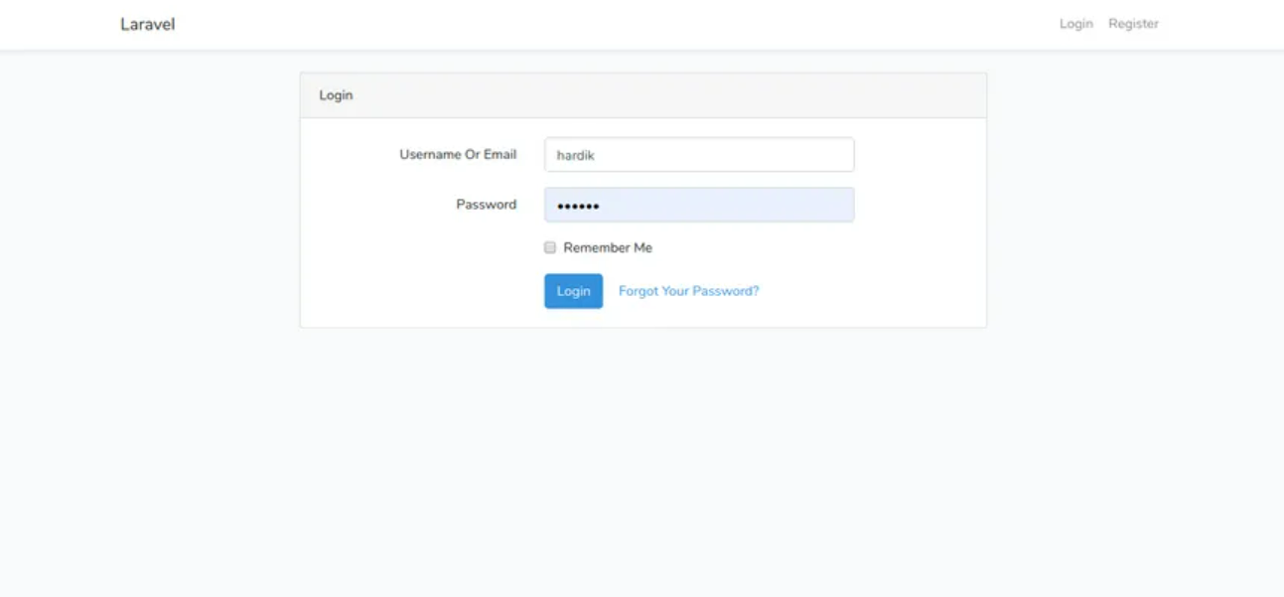
Login with username or email
You can add some dummy records on your users table.
Now you can run your project.
You will get layout
of login page like as bellow:
Rupendra Kaushik laravel Authentication Unit III

Slide 72
Topic Objective
Topic : Protecting routes
Route middleware can be used to only allow authenticated users to access a given route. Laravel ships with an auth middleware, which references the Illuminate\Auth\Middleware\Authenticate class.
Rupendra Kaushik laravel Authentication Unit III

Slide 73
Protecting routes
How To Protect Specific Routes With Middleware
Guests should not be able to submit games
We now have a user registration system in place on our games application. It makes sense then, that now we should only allow registered users to be able to submit new games to the site. In fact since we set up the association between Users in the system to specific Games and Reviews, our store() logic is going to expect that we will provide a user_id when we try to submit a game. If this is not provided, the attempt to insert a new Game will cause an exception to be thrown such as “SQLSTATE[23000]: Integrity constraint violation: 1048 Column ‘user_id’ cannot be null”. As we can see, guests can visit the /games/create route with ease as it stands now. Even if we provide no link to that route, there is nothing stopping a user from simply typing it into their web browser. Notice we even see the Log In link, indicating our guest status.
Rupendra Kaushik laravel Authentication Unit III

Slide 74
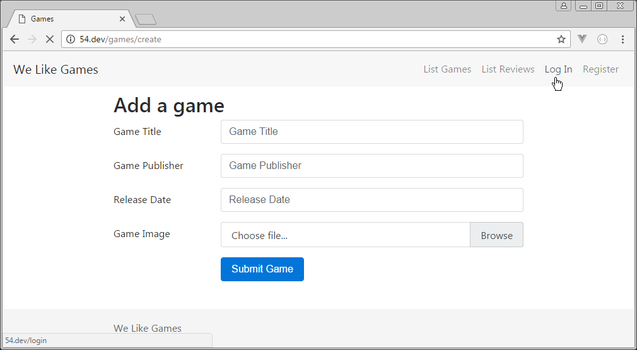
protecting routes
We don’t provide a link to /games/create for guests, but they could simply type it into the browser, like we see above. We can use middleware to prevent them from being able to do this. Since we want to protect something that has to do with a Games resource, we open up the GamesController and apply our middleware like so:
Rupendra Kaushik laravel Authentication Unit III

Slide 75
protecting routes
app/Http/Controllers/GamesController.php
<?php
namespace App\Http\Controllers;
use Illuminate\Http\Request;
use App\Game;
class GamesController extends Controller
{
public function __construct()
{
$this->middleware('auth');
}
public function index()
{
$games = Game::latest()->get();
return view('games.index', ['games' => $games]);
}
Rupendra Kaushik laravel Authentication Unit III

Slide 76
protecting routes
public function show(Game $game)
{
return view('games.show', ['game' => $game]);
}
public function create()
{
return view('games.create');
}
public function store()
{
$this->validate(request(), [
'title' => 'required|unique:games',
'publisher' => 'required',
'releasedate' => 'required',
'image' => 'required',
]);
Rupendra Kaushik laravel Authentication Unit III

Slide 77
protecting routes
$game = new Game;
$game->title = request('title');
$game->publisher = request('publisher');
$game->releasedate = request('releasedate');
$game->image = request()->file('image')->store('public/images');
$game->user_id = auth()->id();
$game->save();
return redirect('/games');
}
}
Rupendra Kaushik laravel Authentication Unit III

Slide 78
Password Confirmation
Laravel form requests are special classes that extend the functionality of regular request classes, enabling advanced validation features. Form requests also help to keep your controller actions a lot cleaner, because you can move all your validation logic to the form request class. Another benefit is that it allows you to filter requests before they reach your controller actions.
It’s always a good idea to put a password confirmation field in your forms since the password is a masked field and the user would never know if they made a typing mistake while filling out the password.
On the backend validation, you just need to use the confirmed validation rule for your password field.
$request->validate([
'password' => 'required|confirmed|min:6'
]);
Also in your HTML, you need to make sure the password field used to input confirmation from the user must be named password_confirmation.
Rupendra Kaushik laravel Authentication Unit III

Slide 79
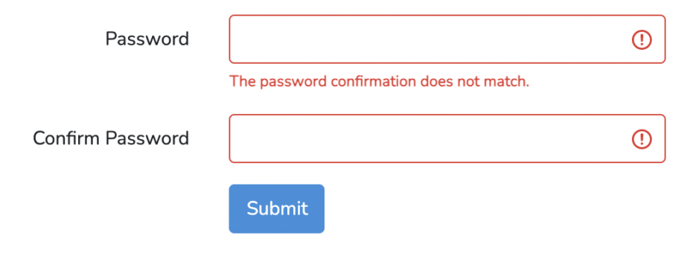
Password Confirmation
<input id="password" type="password" name="password_confirmation" required>
Bootstrap FrontEnd Code for Laravel Password and Confirm Password Validation
Here is the bootstrap form code that includes both the fields and also displays an error when the validation fails.
Rupendra Kaushik laravel Authentication Unit III

Slide 80
Password Confirmation
<div class="form-group row">
<label for="password" class="col-md-4 col-form-label text-md-right">Password</label>
<div class="col-md-6">
<input id="password" type="password" class="form-control @error('password') is-invalid @enderror" name="password" required autocomplete="current-password">
@error('password')
<span class="invalid-feedback" role="alert">
<strong>{{ $message }}</strong>
</span>
@enderror
</div>
</div>
<div class="form-group row">
<label for="password" class="col-md-4 col-form-label text-md-right">Confirm Password</label>
Rupendra Kaushik laravel Authentication Unit III

Slide 81
Password Confirmation
<div class="col-md-6">
<input id="password" type="password" class="form-control @error('password') is-invalid @enderror" name="password_confirmation" required autocomplete="current-password">
</div>
</div>
Rupendra Kaushik laravel Authentication Unit III

Slide 82
Topic Objective
Topic :social & other authentication methods
Authentication and authorization are two vital information security processes that administrators use to protect systems and information. Authentication verifies the identity of a user or service, and authorization determines their access rights.
Rupendra Kaushik laravel Authentication Unit III

Slide 83
social & other authentication methods
Laravel Socialite:
In addition to typical, form based authentication, Laravel also provides a simple, convenient way to authenticate with OAuth providers using Laravel Socialite. Socialite currently supports authentication via Facebook, Twitter, LinkedIn, Google, GitHub, GitLab, and Bitbucket.
Installation
To get started with Socialite, use the Composer package manager to add the package to your project's dependencies:
composer require laravel/socialite
Upgrading Socialite
When upgrading to a new major version of Socialite, it's important that you carefully review the upgrade guide.
Rupendra Kaushik laravel Authentication Unit III

Slide 84
social & other authentication methods
Configuration
Before using Socialite, you will need to add credentials for the OAuth providers your application utilizes. Typically, these credentials may be retrieved by creating a "developer application" within the dashboard of the service you will be authenticating with.
These credentials should be placed in your application's config/services.php configuration file, and should use the key facebook, twitter (OAuth 1.0), twitter-oauth-2 (OAuth 2.0), linkedin, google, github, gitlab, or bitbucket, depending on the providers your application requires:
'github' => [
'client_id' => env('GITHUB_CLIENT_ID'),
'client_secret' => env('GITHUB_CLIENT_SECRET'),
'redirect' => 'http://example.com/callback-url',
],
Rupendra Kaushik laravel Authentication Unit III

Slide 85
social & other authentication methods
Authentication
Routing
To authenticate users using an OAuth provider, you will need two routes: one for redirecting the user to the OAuth provider, and another for receiving the callback from the provider after authentication. The example routes below demonstrate the implementation of both routes.
use Laravel\Socialite\Facades\Socialite;
Route::get('/auth/redirect', function () {
return Socialite::driver('github')->redirect();
});
Route::get('/auth/callback', function () {
$user = Socialite::driver('github')->user();
// $user->token
});
Rupendra Kaushik laravel Authentication Unit III

Slide 86
social & other authentication methods
The redirect method provided by the Socialite facade takes care of redirecting the user to the OAuth provider, while the user method will examine the incoming request and retrieve the user's information from the provider after they have approved the authentication request.
Authentication & Storage
Once the user has been retrieved from the OAuth provider, you may determine if the user exists in your application's database and authenticate the user. If the user does not exist in your application's database, you will typically create a new record in your database to represent the user:
Rupendra Kaushik laravel Authentication Unit III

Slide 87
social & other authentication methods
use App\Models\User;
use Illuminate\Support\Facades\Auth;
use Laravel\Socialite\Facades\Socialite;
Route::get('/auth/callback', function () {
$githubUser = Socialite::driver('github')->user();
$user = User::updateOrCreate([
'github_id' => $githubUser->id,
], [
'name' => $githubUser->name,
'email' => $githubUser->email,
'github_token' => $githubUser->token,
'github_refresh_token' => $githubUser->refreshToken,
]);
Auth::login($user);
return redirect('/dashboard');
});
Rupendra Kaushik laravel Authentication Unit III

Slide 88
Topic Objective
Topic :Show success / Failure message
In this topic we will define various type of flash message notification like alert success, alert danger, alert info, alert warning messages in bootstrap laravel 7 projects.
Rupendra Kaushik laravel Authentication Unit III

Slide 89
Show success / Failure message
Step 1: Create a laravel project
First step is to create the Laravel 8 project using composer command and Laravel artisan command to generate controllers, Model, Components and Migrations.
composer create-project laravel/laravel crud
Step 2: Create a Flash View File
Now, Create a file to show the flash message in our application. In laravel there is 5 types of messages we can show in laravel as follow
Success
Error
Warning
Info
Validations
So lets create file and show them as follow
Rupendra Kaushik laravel Authentication Unit III

Slide 90
Show success / Failure message
@if ($message = Session::get('success'))
<div class="alert alert-success alert-block">
<button type="button" class="close" data-dismiss="alert">×</button>
<strong>{{ $message }}</strong>
</div>
@endif
@if ($message = Session::get('error'))
<div class="alert alert-danger alert-block">
<button type="button" class="close" data-dismiss="alert">×</button>
<strong>{{ $message }}</strong>
</div>
@endif
Rupendra Kaushik laravel Authentication Unit III

Slide 91
Show success / Failure message
@if ($message = Session::get('warning'))
<div class="alert alert-warning alert-block">
<button type="button" class="close" data-dismiss="alert">×</button>
<strong>{{ $message }}</strong>
</div>
@endif
@if ($message = Session::get('info'))
<div class="alert alert-info alert-block">
<button type="button" class="close" data-dismiss="alert">×</button>
<strong>{{ $message }}</strong>
</div>
Rupendra Kaushik laravel Authentication Unit III

Slide 92
Show success / Failure message
@endif
@if ($errors->any())
<div class="alert alert-danger">
<ul>
@foreach ($errors->all() as $error)
<li>{{ $error }}</li>
@endforeach
</ul>
</div>
@endif
Rupendra Kaushik laravel Authentication Unit III

Slide 93
Show success / Failure message
Step 3: Include flash view in theme layout
Next, Include the above create file resources/views/flash-messages.blade.php in our application theme as follow
<!DOCTYPE html>
<html lang="{{ str_replace('_', '-', app()->getLocale()) }}">
<head>
<meta charset="utf-8">
<meta name="viewport" content="width=device-width, initial-scale=1">
<title>How to Show Flash Success and Error Message in Laravel - Readerstacks </title>
<script src="{{asset('js/app.js')}}" crossorigin="anonymous"></script>
<link href="//netdna.bootstrapcdn.com/bootstrap/4.1.1/css/bootstrap.min.css" rel="stylesheet" />
</head>
Rupendra Kaushik laravel Authentication Unit III

Slide 94
Show success / Failure message
<body>
<div class="container">
<div class="panel panel-primary">
<div class="panel-heading">
<h2>How to Show Flash Success and Error Message in Laravel - Readerstacks</h2>
</div>
<div class="panel-body">
@include('flash-message')
@yield('content')
</div>
</div>
</div>
</body>
</html>
This will include the messages view in all pages of application
Rupendra Kaushik laravel Authentication Unit III

Slide 95
Show success / Failure message
Step 4: Show Flash Messages
In this final step we will show the error messages according the message types so you can create a controller a put the follow code
<?php
namespace App\Http\Controllers;
use App\Models\Article;
use Illuminate\Http\Request;
use Illuminate\Support\Facades\Validator;
class ArticleController extends Controller
{
/**
* Display a listing of the resource.
* @return \Illuminate\Http\Response
*/
public function index(Request $request)
{
$articles = Article::paginate(2);
return view('articles.list ', ['articles' => $articles]);
}
Rupendra Kaushik laravel Authentication Unit III

Slide 96
Show success / Failure message
/**
* Show the form for creating a new resource.
*
* @return \Illuminate\Http\Response
*/
public function create()
{
return view('articles.create');
}
/**
* Store a newly created resource in storage.
*
* @param \Illuminate\Http\Request $request
* @return \Illuminate\Http\Response
*/
Rupendra Kaushik laravel Authentication Unit III

Slide 97
Show success / Failure message
public function store(Request $request)
{
$validator = Validator::make($request->all(), [
'title' => "required",
'email' => "required|email|unique:articles",
'image' => 'required|image|mimes:jpeg,png,jpg,gif,svg|max:4096',
]);
if ($validator->fails()) {
return redirect()->back()->withInput()->withErrors($validator->errors());
}
return redirect()->route("articles.index")
->with('success', 'You have successfully created the article.');
}
public function edit($id)
{
return view('articles.update', ["article" => Article::find($id)]);
Rupendra Kaushik laravel Authentication Unit III

Slide 98
Show success / Failure message
public function update(Request $request, $id)
{
$validator = Validator::make($request->all(), [
'title' => "required",
'email' => "required|email|unique:articles,email," . $id,
'image' => 'required|image|mimes:jpeg,png,jpg,gif,svg|max:4096',
]);
if ($validator->fails()) {
$request->session()->flash('error', 'Some Errors in the form');
return redirect()->back()->withInput()->withErrors($validator->errors());
}
return redirect()->route("articles.index")
->with('success', 'You have successfully created the article.');
}
Rupendra Kaushik laravel Authentication Unit III

Slide 99
Show success / Failure message
vpublic function destroy(Request $request,$id)
{
Article::find($id)->delete();
$request->session()->flash('info', 'Just deleted the article');
return redirect()->route("articles.index")
->with('success', 'You have successfully deleted the article.');
}
} So here to show messages we used as follow
Show Error message after validation failed
return redirect()->back()->withInput()->withErrors($validator->errors());
Rupendra Kaushik laravel Authentication Unit III

Slide 100
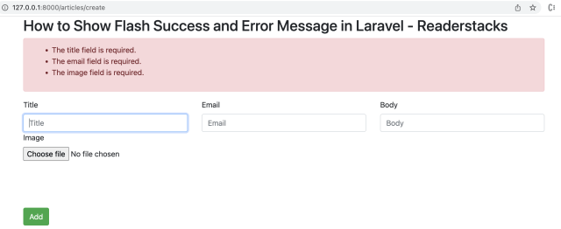
Show success / Failure message
Show Success message After Redirect
return redirect()->route("articles.index")
->with('success', 'You have successfully created the article.');
Rupendra Kaushik laravel Authentication Unit III

Slide 101
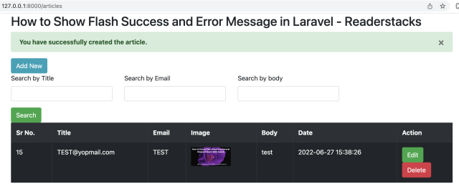
Show success / Failure message
Rupendra Kaushik laravel Authentication Unit III

Slide 102
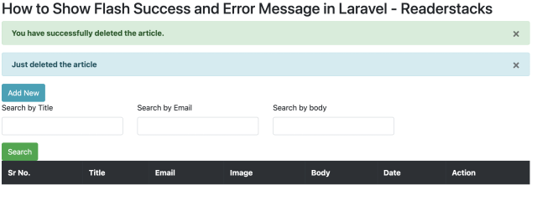
Show success / Failure message
Show Info message After Redirect
return redirect()->route("articles.index")
->with('info', 'You have successfully deleted the article.');
Rupendra Kaushik laravel Authentication Unit III

Slide 103
Topic Objective
Topic : Faker PHP library
Faker is a PHP library that generates fake data for you. Whether you need to bootstrap your database, create good-looking XML documents, fill-in your persistence to stress test it, or anonymize data taken from a production service, Faker is for you.
Rupendra Kaushik laravel Authentication Unit III

Slide 104
Faker PHP library
Faker is a PHP library that generates fake data for you. Whether you need to bootstrap your database, create good-looking XML documents, fill-in your persistence to stress test it, or anonymize data taken from a production service, Faker is for you.
Faker is heavily inspired by Perl's Data::Faker, and by ruby's Faker.
Faker requires PHP >= 5.3.
Installation
composer require fzaninotto/faker
Rupendra Kaushik laravel Authentication Unit III

Slide 105
Faker PHP library
Basic Usage
Autoloading
Faker supports both PSR-0 as PSR-4 autoloaders.
<?php
# When installed via composer
require_once 'vendor/autoload.php’;
You can also load Fakers shipped PSR-0 autoloader
<?php
# Load Fakers own autoloader
require_once '/path/to/Faker/src/autoload.php'
Rupendra Kaushik laravel Authentication Unit III

Slide 106
Faker PHP library
Create fake data
Use Faker\Factory::create() to create and initialize a faker generator, which can generate data by accessing properties named after the type of data you want.
<?php
// use the factory to create a Faker\Generator instance
$faker = Faker\Factory::create();
// generate data by accessing properties
echo $faker->name;
// 'Lucy Cechtelar';
echo $faker->address;
// "426 Jordy Lodge
// Cartwrightshire, SC 88120-6700"
echo $faker->text;
// Dolores sit sint laboriosam dolorem culpa et autem. Beatae nam sunt fugit
// et sit et mollitia sed.
// Fuga deserunt tempora facere magni omnis. Omnis quia temporibus laudantium
// sit minima sint.
Rupendra Kaushik laravel Authentication Unit III

Slide 107
Topic Objective
Topic :Create data seeder
Seed data is data that you populate the database with at the time it is created. You use seeding to provide initial values for lookup lists, for demo purposes, proof of concepts etc.
Rupendra Kaushik laravel Authentication Unit III

Slide 108
Create data seeder
To create seeders, you may use the make:seeder Artisan command. All seeders generated will be placed in the database/seeds directory.
$ php artisan make:seeder MoviesTableSeeder
Generated seeders will contain one method: run. You may insert data into your database in this method.
<?php
use Illuminate\Database\Seeder;
use Illuminate\Database\Eloquent\Model;
class MoviesTableSeeder extends Seeder
{
/**
* Run the database seeds.
*
* @return void
*/
Rupendra Kaushik laravel Authentication Unit III

Slide 109
Create data seeder
public function run()
{
App\Movie::create([
'name' => 'A New Hope',
'year' => '1977'
]);
App\Movie::create([
'name' => 'The Empire Strikes Back',
'year' => '1980'
]);
}
}
You will generally want to call all your seeders inside the DatabaseSeeder class.
Once you're done writing the seeders, use the db:seed command. This will run DatabaseSeeder's run function.
$ php artisan db:seed
Rupendra Kaushik laravel Authentication Unit III

Slide 110
Create data seeder
You may also specify to run a specific seeder class to run individually using the --class option.
$ php artisan db:seed --class=UserSeeder
If you want to rollback and rerun all migrations, and then reseed:
$ php artisan migrate:refresh --seed
The migrate:refresh --seed command is a shortcut to these 3 commands:
$ php artisan migrate:reset # rollback all migrations
$ php artisan migrate # run migrations
$ php artisan db:seed # run seeders
Rupendra Kaushik laravel Authentication Unit III

Slide 111
Topic Objective
Topic :Localisation
Laravel's localization features provide a convenient way to retrieve strings in various languages, allowing you to easily support multiple languages within your application.
Rupendra Kaushik laravel Authentication Unit III

Slide 112
Localisation
Localization feature of Laravel supports different language to be used in application. You need to store all the strings of different language in a file and these files are stored at resources/views directory. You should create a separate directory for each supported language. All the language files should return an array of keyed strings as shown below.
<?php
return [
'welcome' => 'Welcome to the application'
];
Example
Step 1 − Create 3 files for languages − English, French, and German. Save English file at resources/lang/en/lang.php
<?php
return [
'msg' => 'Laravel Internationalization example.'
];
?>
Rupendra Kaushik laravel Authentication Unit III

Slide 113
Localisation
Step 2 − Save French file at resources/lang/fr/lang.php.
<?php
return [
'msg' => 'Exemple Laravel internationalisation.'
];
?>
Step 3 − Save German file at resources/lang/de/lang.php.
<?php
return [
'msg' => 'Laravel Internationalisierung Beispiel.'
];
?>
Rupendra Kaushik laravel Authentication Unit III

Slide 114
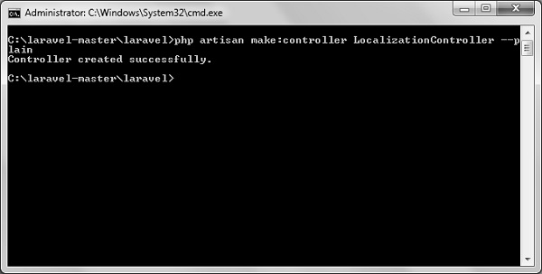
Localisation
hbStep 4 − Create a controller called LocalizationController by executing the following command.
php artisan make:controller LocalizationController --plain
Step 5 − After successful execution, you will receive the following output −hb
Rupendra Kaushik laravel Authentication Unit III

Slide 115
Localisation
Step 6 − Copy the following code to file
app/Http/Controllers/LocalizationController.php
app/Http/Controllers/LocalizationController.php
<?php
namespace App\Http\Controllers;
use Illuminate\Http\Request;
use App\Http\Requests;
use App\Http\Controllers\Controller;
class LocalizationController extends Controller {
public function index(Request $request,$locale) {
//set’s application’s locale
app()->setLocale($locale);
//Gets the translated message and displays it
echo trans('lang.msg');
}
}
Rupendra Kaushik laravel Authentication Unit III

Slide 116
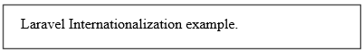
Localisation
Step 7 − Add a route for LocalizationController in app/Http/routes.php file. Notice that we are passing {locale} argument after localization/ which we will use to see output in different language.
app/Http/routes.php
Route::get('localization/{locale}','LocalizationController@index');
Step 8 − Now, let us visit the different URLs to see all different languages. Execute the below URL to see output in English language.
http://localhost:8000/localization/en
Step 9 − The output will appear as shown in the following image.
Rupendra Kaushik laravel Authentication Unit III

Slide 117
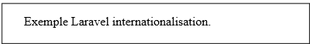
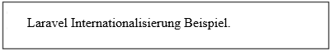
Localisation
Step 10 − Execute the below URL to see output in French language.
http://localhost:8000/localization/fr
Step 11 − The output will appear as shown in the following image.
Step 12 − Execute the below URL to see output in German language
http://localhost:8000/localization/de
Step 13 − The output will appear as shown in the following image.
Rupendra Kaushik laravel Authentication Unit III

Slide 118
Topic Objective
Topic :Model Factories
Laravel Model Factories provide a convenient way to populate your database with Dummy Data during development as well as provide a way to insert Records while running Tests.
Rupendra Kaushik laravel Authentication Unit III

Slide 119
Model Factories
Starting
Let’s start by creating a new project named Factories. To do this, run the following command:
laravel new Factories
This will create a new Laravel project within a folder named Factories.
Creating a new Model
Now, let’s create a Post model and a migration for it. To do this run the following command from the project root directory:
php artisan make:model Post -m
This command will create a new Post model and because we added -m or --migration flag, it will create a migration for it as well. This command will create two files at app/Post.php and database/migrations/create_posts_table.php. Create posts table relationship with the user by opening app/User.php and defining the following relation:
Rupendra Kaushik laravel Authentication Unit III

Slide 120
Model Factories
public function posts()
{
return $this->hasMany(Post::class);
}
Setting up Database
Now, go to your .env file and change credentials for your database. Since it is just a dummy project, I will go with SQLite. To use SQLite, set DB_CONNECTION to sqlite and remove all other DB_* lines from your .env. Your .env database part now look like this:
DB_CONNECTION=sqlite
Now that you have set DB_CONNECTION to sqlite, create a file named database.sqlite in your database directory in the root of your application. Also, run the following command to configure your cache.
php artisan config:cache
Rupendra Kaushik laravel Authentication Unit III

Slide 121
Daily Quiz
1. CLI Command to migrate in Laravel project?
php artisan create migration
php artisan migrate
php artisan serve
None of the above
2. By default laravel project runs on which PORT?
3000
5000
8000
7000
Rupendra Kaushik laravel Authentication Unit III

Slide 122
Daily Quiz
3. Where is the routing file located in Laravel ?
app/Http/
routes/
urls/
vendors/
4. Which directory contain “robot.txt” file ?
app
public
config
storage
Rupendra Kaushik laravel Authentication Unit III

Slide 123
Daily Quiz
5. Where do we need to set database connection in Laravel?
config.php
setting.php
In seed files
.ENV file
6. Can laravel application support caching?
Yes
No
Can't Say
None of these
Rupendra Kaushik laravel Authentication Unit III

Slide 124
Faculty Video Links, Youtube & NPTEL Video Links and Online Courses Details
https://www.youtube.com/watch?v=ImtZ5yENzgE&ab_channel=freeCodeCamp.org
https://www.youtube.com/watch?v=0yVDMcGp97g&list=PLjVLYmrlmjGfh2rwJjrmKNHzGxCZwBsqj&ab_channel=WsCubeTech
https://laravel.com/docs/4.2/introduction#:~:text=Laravel%20attempts%20to%20take%20the,developer%20without%20sacrificing%20application%20functionality.
https://www.tutorialspoint.com/laravel/laravel_overview.htm
https://www.javatpoint.com/laravel
https://codesource.io/brief-overview-of-design-pattern-used-in-laravel/
https://www.javatpoint.com/laravel-blade-template
https://readerstacks.com/how-to-show-success-and-error-flash-message-in-laravel/
Rupendra Kaushik laravel Authentication Unit III

Slide 125
Weekly Assignment
What are the default route files in Laravel?
What is the Laravel Framework?
What are available databases supported by Laravel?
What is an artisan?
How to define environment variables in Laravel?
How to put Laravel applications in maintenance mode?
What are the advantages of using the Laravel framework to build complex web applications?
What is MVC architecture?
How to create a route? Briefly describe with an example.
Rupendra Kaushik laravel Authentication Unit III

Slide 126
MCQ s
1. What is the use of .env file in Laravel?
Setting Up local Environment variable
Optimization
Hosting
None of these
2. Command to start Laravel Application?
php artisan new
php artisan
php artisan start
php artisan serve
Rupendra Kaushik laravel Authentication Unit III

Slide 127
MCQ s
3. Command to install laravel project?
composer create-project laravel/laravel myproject
composer new-project laravel/laravel myproject
composer create-project new laravel/laravel myproject
None of these
4. CLI Command to migrate in Laravel project?
php artisan create migration
php artisan migrate
php artisan serve
None of the above
Rupendra Kaushik laravel Authentication Unit III

Slide 128
MCQ s
5. Command to make migration in laravel?
php artisan migration table
php artisan make:migration create_tags_table
php artisan make-migration digit
None of these
6. Command to check the status of migration in laravel application?
php artisan migration status
php artisan status
php artisan migrate:status
None of these
Rupendra Kaushik laravel Authentication Unit III

Slide 129
Glossary Questions
1. Laravel currently support several databases?
True
False
2. Which file is responsible for the application URL, timezone, localeautoload service provider?
auth.php
app.php
cache.php
compile.php
3. ………………method returns the average value of a given key ?
average()
avg()
median()
avg_val()
Rupendra Kaushik laravel Authentication Unit III

Slide 130
Glossary Questions
4. Which of the following is true about Laravel?
Laravel is an open-source PHP framework
Laravel is robust
Laravel is easy to understand
All of the above
5. Laravel uses ___________ to connect to an existing session and general-purpose cache
Queues
Cron
Redis
Command Bus
6. Where do we need to set database connection in Laravel?
setting.php
config.php
ENV file
In seed files
Rupendra Kaushik laravel Authentication Unit III

Slide 131
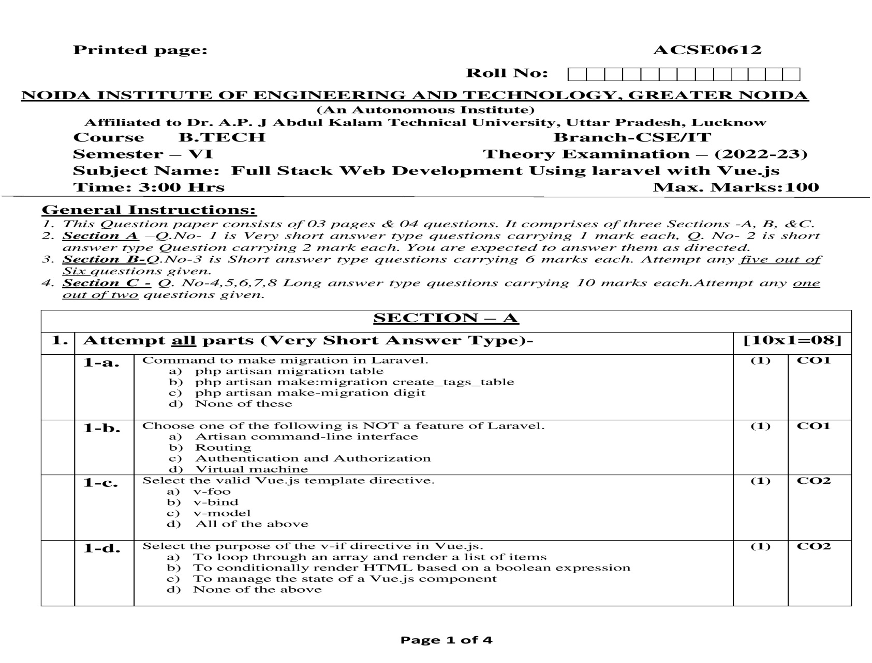
Old Question Paper

Slide 132
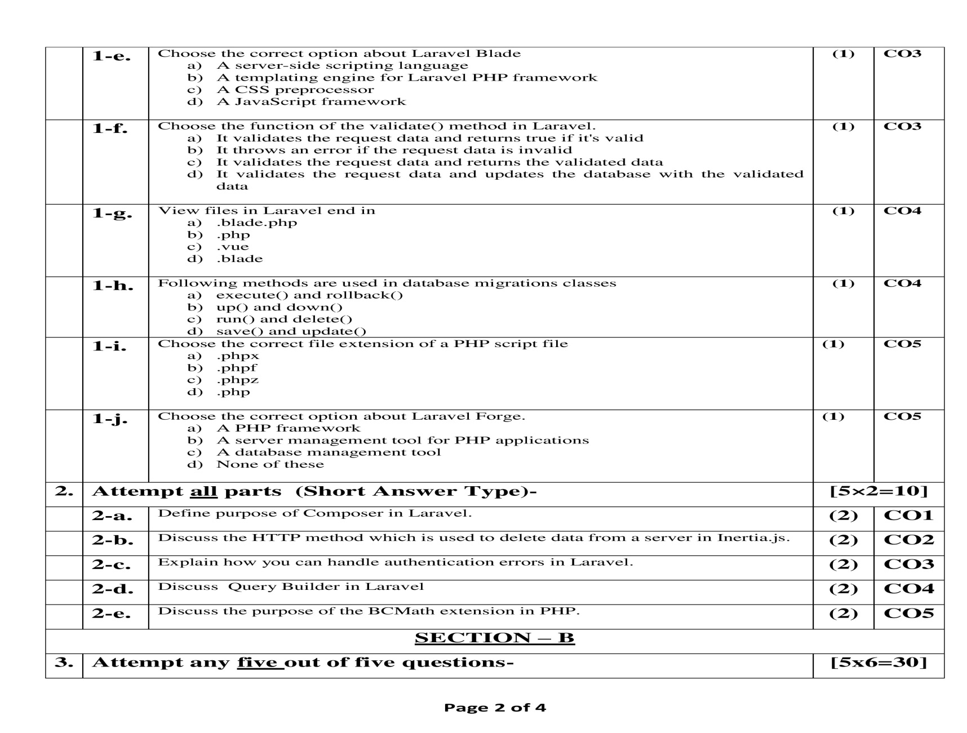
Old Question Paper

Slide 133
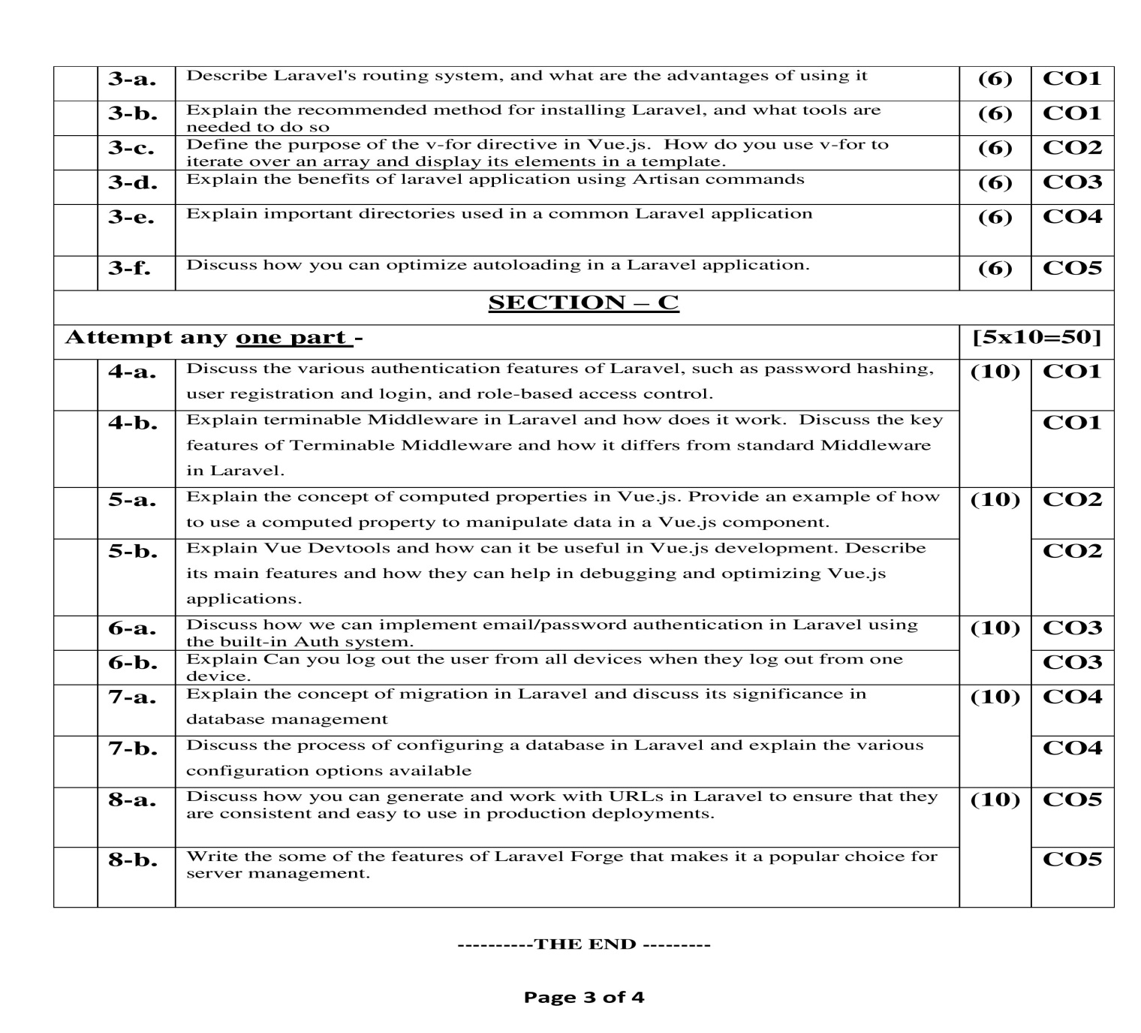
Old Question Paper

Slide 134
Expected Questions for University Exam
Where can you easily hook on validation in Laravel 5.x?
List some Aggregates methods provided by query builder in Laravel ?
What are Laravel events?
How will you explain middleware in Laravel?
What are some benefits of Laravel over other Php frameworks?
What are some Differences and Similarities Between Lumen and Laravel?
How to Rollback one specific migration in Laravel?
Rupendra Kaushik laravel Authentication Unit III

Slide 135
Recap of unit
Students learnt:
Design point of view students learnt Laravel design patter
Students have learnt Laravel blade template engine
Artisan command
How to create update and Login with username or email
For security point of view student learnt Protecting Router, Password Confirmation, Social & Other Authentication method
Faker PHP library, Create data seeder, Seed data,
Localisation
Model Factories
Rupendra Kaushik laravel Authentication Unit III

Slide 136
Thank You
Rupendra Kaushik laravel Authentication Unit III

